Slide 1
Z+ AUTHORIZATION
Priyank Bhaveshbhai Siddhapura
Karankumar Patel
Meet Hitesh Mistry
Raj Tandel

Slide 2
Project Summary
There are total two parts of this project
1. Starter App
2. Authorization Part
The project is totally based on DotNet core.
According to the provided instructions there are three roles in the project that are registered user, manager and admin.
Registered user can see the approved, rejected data on their side.
Manager can approve and reject the data request by the users.
Admin can approve/reject as well as edit/delete the contact data of users.

Slide 3
Project Summary
We have run all the commands using CLI (Command-line interface)
The first step in our project was to create the web app in Dotnet core. To create “ContactManger” web app the command that we used is as follow:
dotnet new webapp -o ContactManager -au Individual -uld
Secondly, once the web app was created, we have manually added the data using the instructions provided on the website.
After that, we call the data in the program.cs file.
Once the Starter app runs properly, we have added authorization to every user login.
After that, we have added the role services according to the roles.
Then we have configured the test account.
After that we created the test/dummy accounts and then updated the contacts.

Slide 4
Project Summary
Once the test data was created, we have created the authorization handler for all the three roles.
After creation of authorization handler, we have updated the create model, index model, edit model and delete model.
During our project we faced an error of “dotnet ef not found”. Which was solved using following command line code:
Dotnet tool install –-global dotnet-ef –version 6.*

Slide 5
About us
There are four members in our group.
Priyank Bhaveshbhai Siddhapura
Karankumar Patel
Meet Hitesh Mistry
Raj Tandel
Priyank has completed his Bachelor’s degree in Physics. Karankumar and raj had pursued Bachelor’s degree in Mathematics. Meet has completed his Engineering degree in Computer Science.
In this project, we have tried to distribute task equally, so that everyone’s contribution in project remains same and can learn from it as well.
Work done by each member will be discussed during presentation.

Slide 6
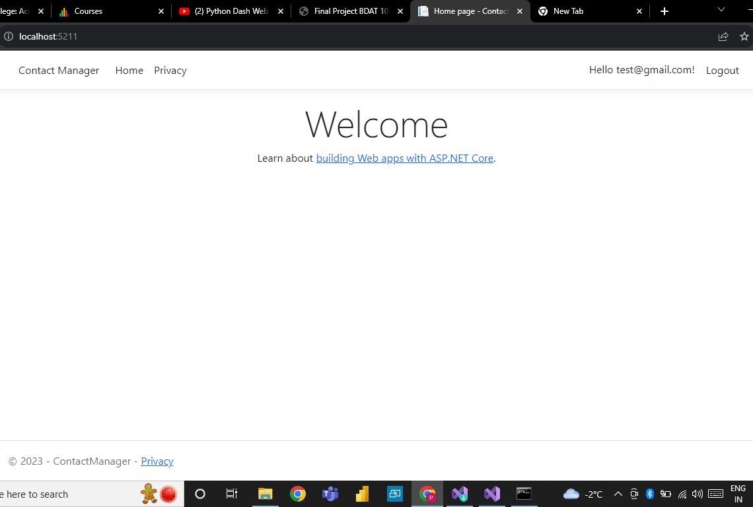
Part-1 Demonstration
Welcome page view of registered User account

Slide 7
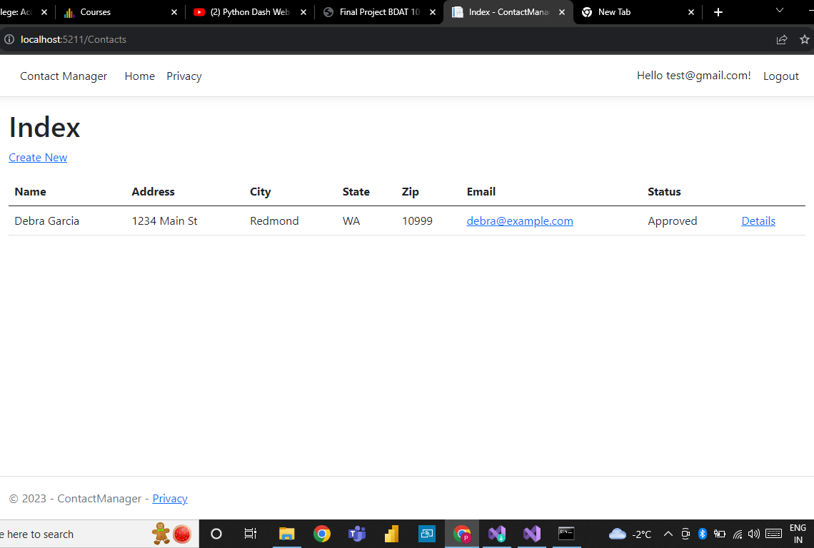
Part-1 Demonstration
Registered user view for all the approved data.
They can also edit, delete and see their details.

Slide 8
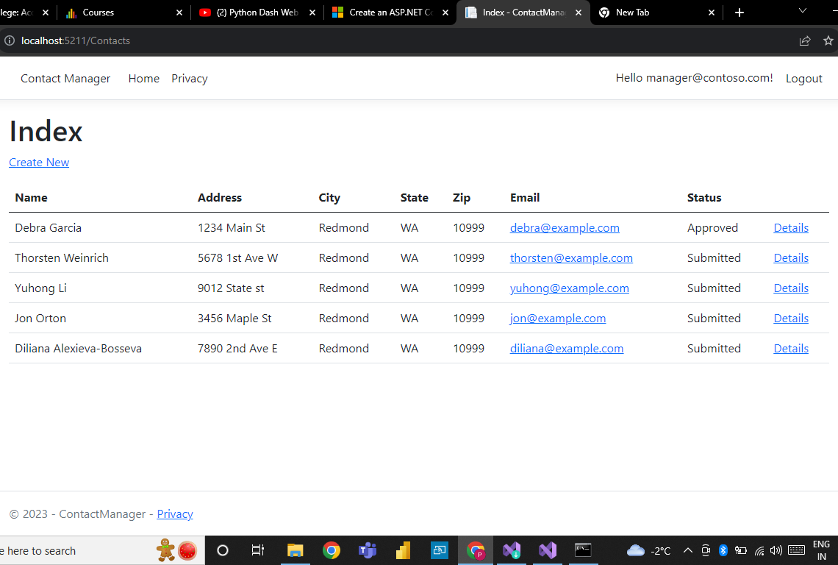
Part-1 Demonstration
Show picture illustrate view for Managers who is authorized to approve or reject contact data.

Slide 9
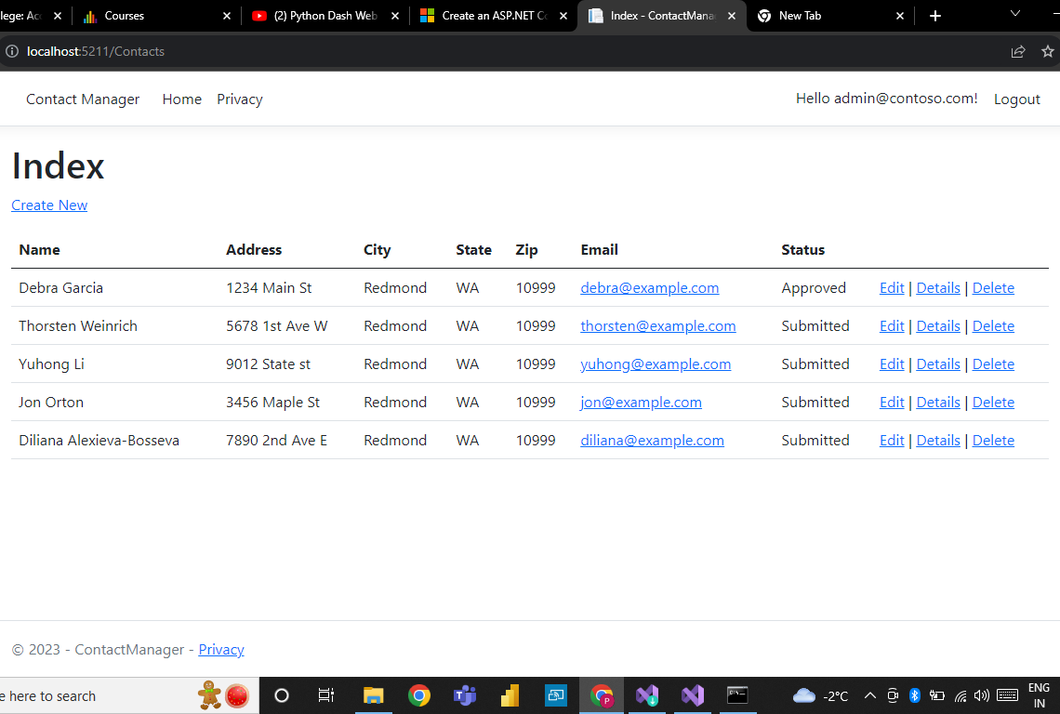
Part-1 Demonstration
Admin has full authorization as he/she has power to approve, reject, edit or delete any data.

Slide 10
Thank you.

